Slide 1
CHAPTER – 4
The X Window System

Slide 2
Objectives:
At the end of this module, you would have gained fair knowledge on:
Configuring X Window System
Different windows manager
Different tools available in X Window

Slide 3
The Power of X
Linux began as a powerful, server-based operating system, excelling at efficiently processing complicated programs requiring high CPU utilization and handling requests from hundreds or thousands of clients through network connections. However, because of its open nature and stability, Linux has quickly developed into a popular GUI-based operating system for workstations, both in the home and in the workplace.
In the UNIX™ world, windowing environments have existed for decades, predating many of the current mainstream operating systems. The X Window System is now the dominant graphical user interface (GUI) for UNIX-like operating systems.

Slide 4
In the UNIX™ world, windowing environments have existed for decades, predating many of the current mainstream operating systems. The X Window System is now the dominant graphical user interface (GUI) for UNIX-like operating systems.
To create this GUI for the user, X uses client-server architecture. An X server process is started and X client processes can connect to it via a network or local loopback interface. The server process handles the communication with the hardware, such as the video card, monitor, keyboard, and mouse. The X client exists in the user-space, issuing requests to the X server.

Slide 5
XFree86
Red Hat Linux 8.0 uses XFree86 version 4.2 as the base X Window System, which includes the necessary X libraries, fonts, utilities, documentation, and development tools.
The X server includes many cutting edge XFree86 technology enhancements such as hardware 3D acceleration support, the XRender extension for anti-aliased fonts, a modular driver based design, support for modern video hardware and input devices, and many other features

Slide 6
/usr/X11R6/ directory
A directory containing X client binaries (the bin directory), assorted header files (the include directory), libraries (the lib directory), and manual pages (the man directory), and various other X documentation (the /usr/X11R6/lib/X11/doc/ directory).
/etc/X11/ directory
The /etc/X11/ directory hierarchy contains all of the configuration files for the various components that make up the X Window System. This includes configuration files for the X server itself, the X font server (xfs), the X Display Manager (xdm), and many other base components. Display managers such as gdm and kdm, as well as various window managers, and other X tools also store their configuration in this hierarchy.

Slide 7
XFree86 Server Configuration Files
The XFree86 server configuration files are stored in the /etc/X11/ directory. The XFree86 version 4 server uses /etc/X11/XF86Config. When Red Hat Linux is installed, the configuration files for XFree86 are created using information gathered during the installation process.
While there is rarely a need to manually edit these files, it is useful to know about the various sections and optional parameters found in them.

Slide 8
Device
• BusID — Specifies the bus location of the video card.
• Driver — Tells XFree86 which driver to load in order to use the video card.
• Identifier — Provides a unique name for this video card. Usually, this name is set to the exact name of the video card used in the Device section.
• Screen — An optional setting used when a video card has more than one head, or connector, to go out to a separate monitor. exist for each of them with a different Screen value for each Device section.
VideoRam — The amount of RAM available on the video card in kilobytes. This setting is not normally necessary since the XFree86 server can usually probe the video card to autodetect the amount of video RAM.

Slide 9
Desktop Environments and Window Managers
The configuration of an XFree86 server is useless until accessed by an X client that will use it to display a program using the hardware controlled by the X server. X clients are programs designed to take advantage of the X server's hardware, usually to provide interactivity with a user.
You do not have to run a complicated window manager in conjunction with a particular desktop environment to use X client applications. Assuming that you are not already in an X environment and do not have an .xinitrc file in your home directory, type the xinit command to start X with a basic terminal window .

Slide 10
Window Managers
Window managers are X client programs that control the way other X clients are positioned, resized, or moved. Window managers can also provide title bars to windows, keyboard focus by keyboard or mouse, and user-specified key and mouse button bindings.
Window managers work with a collection of different X clients, wrapping around the program, making it look a certain way and appear on the screen in a particular place.

Slide 11
Four window managers are included with Red Hat Linux 8.0:
• twm — The minimalist Tab Window Manager, which provides the most basic toolset of any of the window managers.
• mwm — The default window manager for the GNOME desktop environment, mwm stands for Metacity Window Manager. It is a simple and efficient window manager that supports custom themes.
• sawfish — This full featured window manager was the default until the release of Red Hat Linux 8.0. It can be used either with or without the GNOME desktop environment.
wmaker — WindowMaker is a full-featured GNU window manager designed to emulate the look and feel of the NEXTSTEP environment

Slide 12
Desktop Environments
A desktop environment brings together assorted X clients that can be run together using similar methods, utilizing a common development environment
GNOME is the default desktop environment for Red Hat Linux, using the GTK2 base widget toolkit and miscellaneous other widgets that extend the base functionality.

Slide 13
KDE, another desktop environment, uses a different toolkit called Qt.
GNOME and KDE both contain advanced productivity applications, such as word processors, spreadsheets, and control panel devices that allow you to have complete control of the look-and-feel of your user experience. Both environments can run standard X client applications, and most KDE applications can run in GNOME, if the Qt libraries are installed.
Desktop Environments

Slide 14
Runlevels
The default runlevel used when your system boots can be found in the /etc/inittab file. If you have a line in that file that looks like id:3:initdefault:, then your system will boot to runlevel 3. If you have a line that looks like id:5:initdefault:, your system is set to boot into runlevel 5. As root, change the runlevel number in this file to set a different default. Save the file and restart your system to verify that it boots to the correct runlevel.
Runlevel 3: startx
When in runlevel 3, the preferred way to start an X session is to type the startx command. startx, a front-end to the xinit program, launches the XFree86 server and connects the X clients to it. Because you must already be logged into the system at runlevel 3 to be able to type commands, startx is only designed to bring up certain X clients, such as a desktop environment, in a particular manner. It does not provide any user authentication

Slide 15
Runlevel 5: prefdm
Runlevel 5 uses a slightly different method to start X. When the system starts, no one is logged into the system by default. In order for a user to start a session, they must log in to the system. In runlevel 5, users authenticating themselves at the console use a display manager, a special X client that allows the user to submit their login name and password.
Depending on the desktop environments installed on your specific Red Hat Linux system, three different display managers are available to handle the user authentication.
The xdm display manager is the original X authentication tool. xdm only allows you to log in and start an X session.
The gdm display manager, designed to work with the GNOME desktop environment.
kdm display manager, used with the KDE desktop environment,

Slide 16
Fonts
Red Hat Linux uses xfs (X Font Server) to provide fonts to the XFree86 server and the X client applications that connect to it. While it is possible to not use xfs and place the paths to font directories in your XF86Config configuration file, xfs has several advantages:
• It is easier to add and remove fonts, including editing the font path. The font path is a collection of paths in the file system where font files are stored. The xfs service keeps the font path out of the XFree86 configuration files, making it easier to edit.
• Fonts may be stored on one machine acting as a networked font server and can be shared among multiple X servers over the network. A common set of fonts can be maintained in one place and easily shared between all users.
•
More types of fonts are supported. xfs can handle TrueType, Type1, and bitmap fonts.

Slide 17
xfs Configuration
The /etc/rc.d/init.d/xfs script starts the xfs server. Several options can be configured in the /etc/X11/fs/config file:
• Alternate-servers — Sets a list of alternate font servers to be used if this font server is not available. A comma must separate every font server in the list.
• catalogue — An ordered list of font paths to use that contain the font files. A comma must follow every font path before a new font path can be started in the list.

Slide 18
Adding Fonts
1. Create a font directory, such as /usr/share/fonts and place the fonts inside that directory. Be sure to set the permissions correctly; it is only necessary that the files can be read, no other permissions are necessary.
2. 1. Type the chkfontpath --add <font-directory-path> command, where the <font-directory-path> is the full path to the directory holding the fonts. This will add this font path to the xfs configuration file.
3. 2. Restart xfs using the /sbin/service xfs restart command. You will also need to restart your X session.
4. 3.Typing the chkfontpath --list command will show the new font path. Any fonts you added will be available for use.

Slide 19
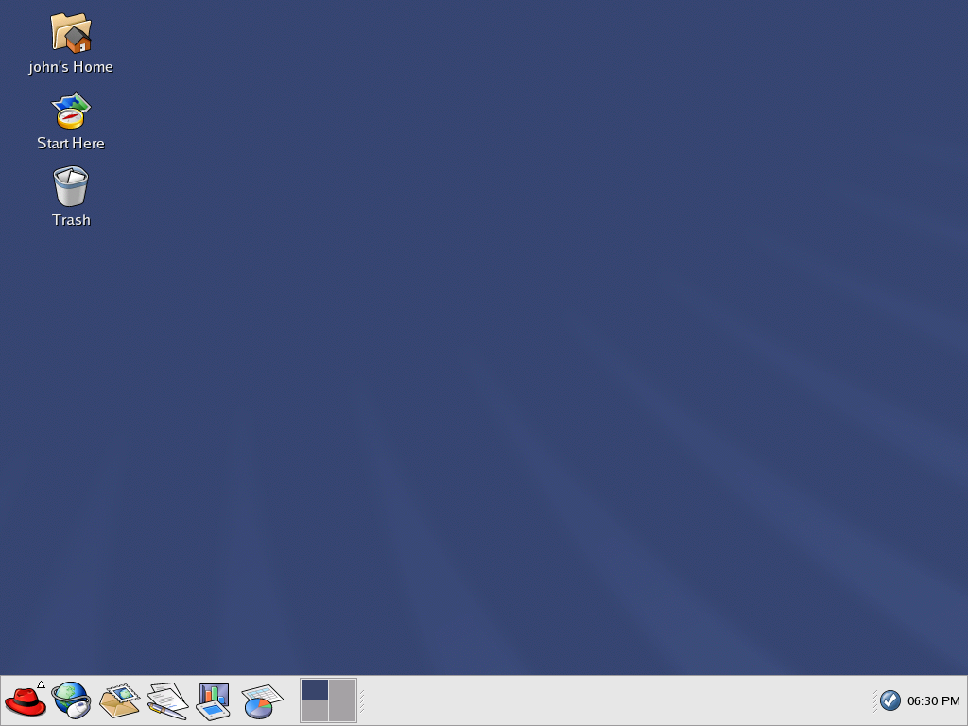
Using the Desktop

Slide 20
Control panel Display
The desktop panel is the bar that stretches across the bottom of the screen and holds icons and small applications which makes using your system easier. The panel also holds the Main Menu which contains menu items for all of your applications. Applets allow you to run specific tasks or monitor your system or services, like Red Hat Network, while remaining out of your way

Slide 21
Using the Main Menu
You can click on the panel Main Menu button to expand it into a large set of menus that allows you to access the applications on your system.
There are a few applets that run on your panel by default. These applets are fairly important and are covered in the following list.

Slide 22

Workspace Switcher
The Workspace Switcher is a simple applet that allows you to see what applications you have open on your desktops. The graphical desktop gives you the ability to use multiple workspaces so you do not have to have all your running applications crowding one viewable desktop area.

Slide 23
Taskbar
Next to the Workspace Switcher is the Taskbar. The taskbar is an applet which shows you the titles of running applications on any desktop. This is very helpful if you decide to minimize an application as it will seem to disappear from the desktop.

Slide 24

Using the Notification Area
Red Hat Network Notification Tool

Slide 25

The Authentication Icon

Slide 26

Using Nautilus
The graphical desktop includes a file manager called Nautilus that gives you a graphical display of your system and personal files. Nautilus is designed to be much more than a visual listing of files, however. It allows you to configure your desktop, configure your Red Hat Linux system, play your digital music and video files, browse your photo collection, access your network resources, and more all from one integrated interface. In essence, Nautilus becomes a shell for your entire desktop experience

Slide 27
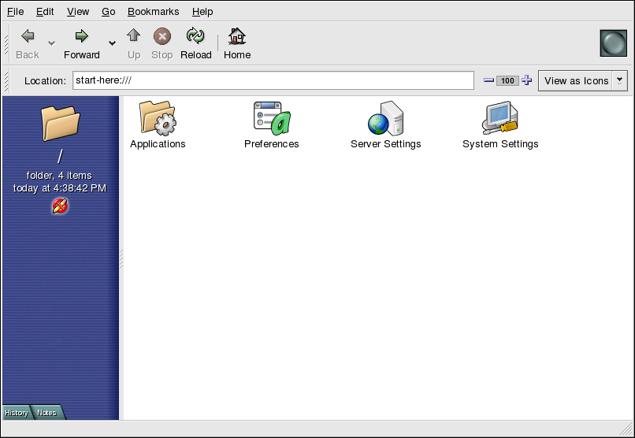
Start Here
Start Here was designed to hold all of the tools and applications you need to access when using your system. From your favorite applications to system and configuration tools, the Start Here window provides a central location for using and customizing your system.

Slide 28
Customizing the Desktop
Background
You can configure your background with new colors or a new image.
Sound
In this section you can configure the system sounds associated with various functions. For example, if you would like to have a sound play when you log in to your desktop, you can configure that here.
Keyboard Shortcuts
You can configure shortcuts — pressing a combination of keystrokes on the keyboard — to perform actions within an application or on your desktop.

Slide 29
Customizing your System
Date & Time :
This tool allows you to set the date and time of your machine. You will be able to set your time zone information as well. Refer to the Official Red Hat Linux Customization Guide for more details on using this tool.
Soundcard Detection :
The Soundcard Detection tool probes your machine for available sound devices.
Users & Groups :
The Users & Groups tool allows you to add and remove users from your system.
Printing :
The Printer Configuration Tool allows you to add a new printer to your system. The printer may be connected to your machine or available on a network.

Slide 30
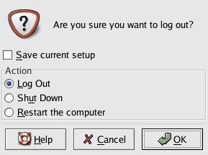
Logging Out

Slide 31
Mounting and Unmounting a Diskette
A diskette must be mounted first before it can be used. Insert a diskette into the diskette drive and type mount /mnt/floppy/ at a shell prompt.
The diskette drive activity light should blink as the diskette's file system is mounted to the /mnt/floppy directory. You can access the contents of the diskette by changing into that directory with the cd /mnt/floppy/ command.
Alternatively, you can also mount a diskette by right-clicking on the desktop and choosing Disks => Floppy. This mounts the diskette and adds a desktop icon which you can double click to explore the diskette contents.

Slide 32
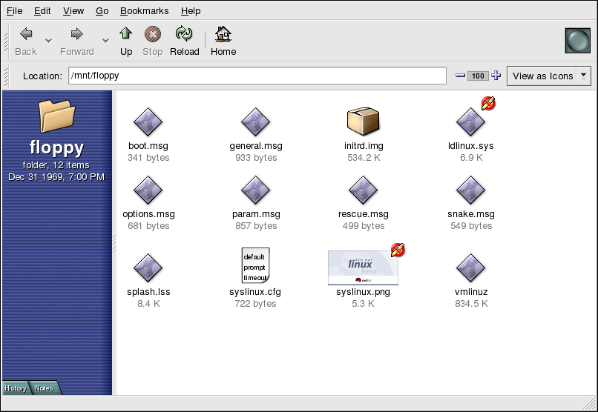
Now that the diskette has been mounted it is available to be copied from or written to. You can open, save, and copy files to/from it as you would normally do to your hard drive. You can even explore the diskette's contents in Nautilus.

Slide 33
When you are done using the diskette, you should unmount it before ejecting it from the drive. To do this, close any applications that may be using files on the diskette or exploring the diskette's contents (such as Nautilus or Konqueror), and at a shell prompt type the following command :
# umount /mnt/floppy/
If you are using GNOME, unmount the diskette by right-clicking on the icon and choosing Unmount Volume from the menu.

Slide 34
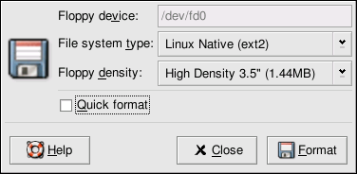
Formatting a Diskette
Using gfloppy:
To start gfloppy, choose Main Menu => System Tools => Floppy Formatter. From a shell prompt, type /usr/bin/gfloppy. As shown in the figure given below, the gfloppy interface is small and has few options. The default settings are sufficient for most users and needs; however, you can format your diskette with an MS-DOS file system type if you desire. You can also choose the density of your floppy disk (if you are not using the usual high density 3.5" 1.44MB diskette. You can also elect to quick format the diskette if it was previously formatted as ext2.

Slide 35
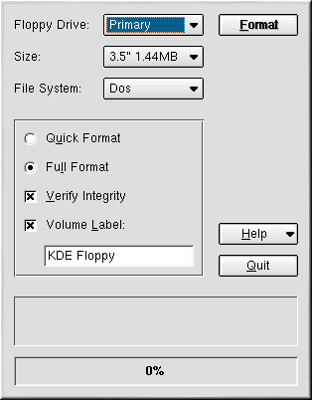
Using KFloppy
Another way to format a diskette for either ext2 or MS-DOS is to use KFloppy. To start the utility, open a shell prompt and type the command kfloppy. You will be presented with a graphical interface shown in the figure below.

Slide 36
CD-ROMs
The CD-ROM format is a popular way to deliver typically large software applications and multimedia presentations. Most of the software that can be purchased from retail outlets come in the form of CD-ROMs. This section shows you how to use CD-ROMs on your Red Hat Linux system.
By default, Red Hat Linux automatically detects if a CD-ROM is inserted in the CD-ROM device. The disc will then be mounted and your file manager will open a window with the drives contents for you to explore.

Slide 37
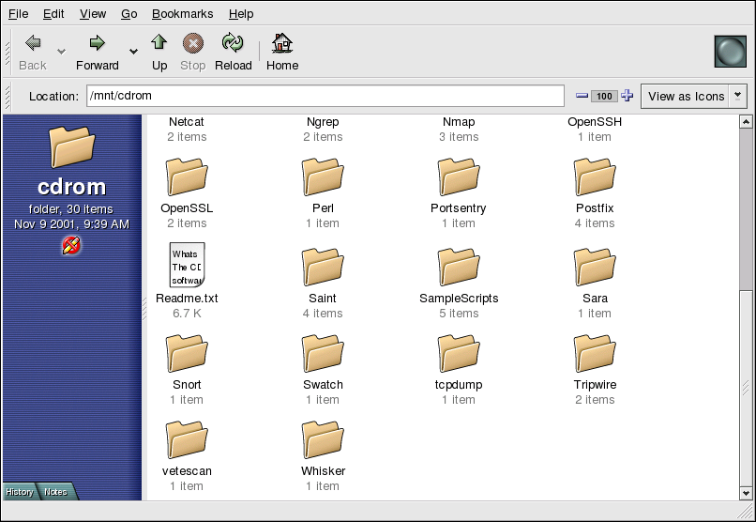

A CD desktop icon will also appear, which you can use to unmount and eject your CD-ROM after use. Right-click on the icon to view all of the available choices. For example, to unmount and eject the CD-ROM, choose Eject from the menu.

Slide 38
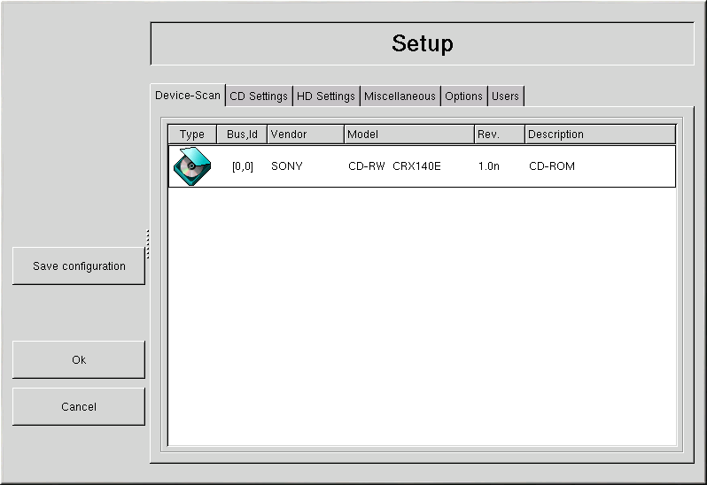
Using X-CD-Roast
X-CD-Roast is a graphical application for duplicating and creating (mastering) CD-ROMs. X-CD-Roast automates the process of burning CD-Rs and CD-RWs and is highly configurable to many CD mastering or duplicating needs.

Slide 39
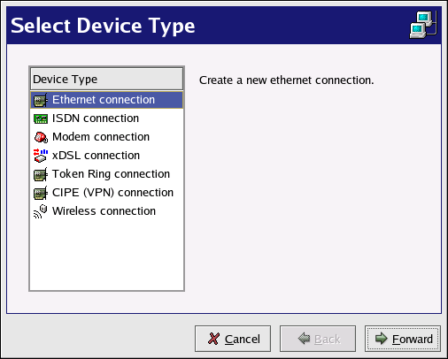
Getting Online
There are many types of Internet connections including:
• ISDN Connection
• Modem Connection
• xDSL Connection
• Cable Modem Connection

Slide 40
ISDN Connection
An ISDN (Integrated Services Digital Network) connection uses high-speed, high-quality digital telecommunication lines as opposed to an analog modem connection. This special phone line must be installed by a phone company. To configure this type of connection, start Internet Druid, select ISDN Connection, and follow the steps in the wizard.
Modem Connection
A modem connection uses a modem to establish a connection to the Internet. Digital data is modulated into analog signals and sent over phone lines. To configure this type of connection, start Internet Druid, select Modem Connection, and follow the steps in the wizard. xDSL Connection
An xDSL (Digital Subscriber Line) connection uses high-speed transmissions through telephone lines. There are different types of DSL such as ADSL, IDSL, and SDSL. Internet Druid uses the term xDSL to mean all types of DSL connections.

Slide 41
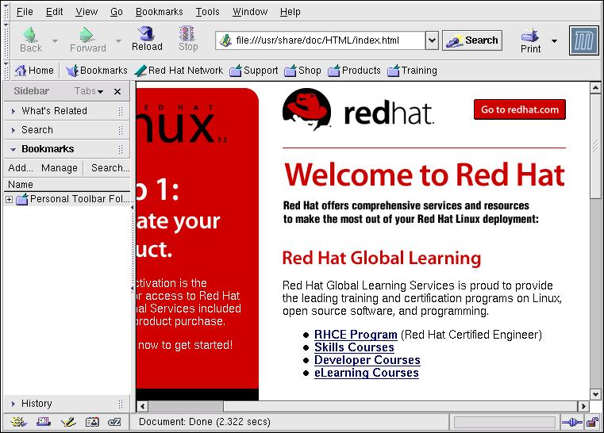
Web Browsing
Once you have configured your Internet connection you are ready to get online. Red Hat Linux comes with several open source browsers for you to choose from. This chapter briefly explains how to surf the Web using the following browsers:
• Mozilla
• Nautilus
• Konqueror
• Galeon

Slide 42
Email Applications
Email is a very popular way of communicating with others over the Internet. You can use email with an email client, an application that understands the various email transmission standards and allows you to send, receive, and read email.
Red Hat Linux includes several email applications, including graphical email clients like Evolution and Mozilla Mail, and text-based clients like Pine and mutt. All of the email client applications are designed to suit certain types of users; so, you can choose one with the features that best suits your particular needs.

Slide 43
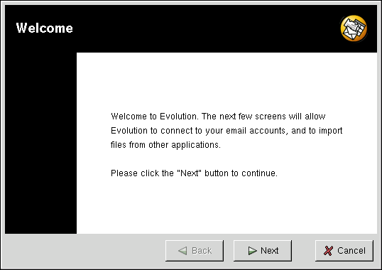
Evolution
Evolution is more than just an email client. It provides all of the standard email client features, including powerful mailbox management, user-defined filters, and quick searches. It additionally features a flexible calendar/scheduler which allows users to create and confirm group meetings and special events online. Evolution is a full-featured personal and workgroup information management tool for Linux and UNIX-based systems, and is the default email client for Red Hat Linux.
To launch Evolution from the desktop panel, go to Main Menu => Internet => Email.

Slide 44
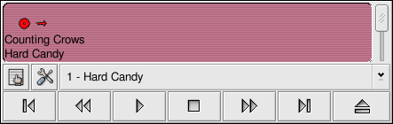
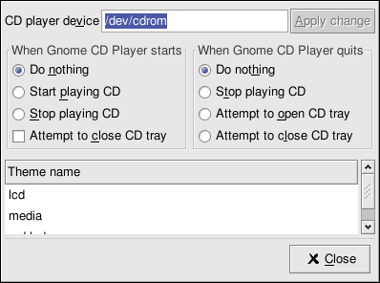
Multimedia and General Amusement
CD Player

Slide 45
XMMS can be used for more than just playing digital audio files. By default XMMS can play Ogg Vorbis, RIFF wave, and most module formats. XMMS can be extended through plugins to play a number of other digital multimedia formats.
To launch XMMS, go to Main Menu => Sound & Video => XMMS.
To launch XMMS from a shell prompt, type the command xmms.

